Slide 1
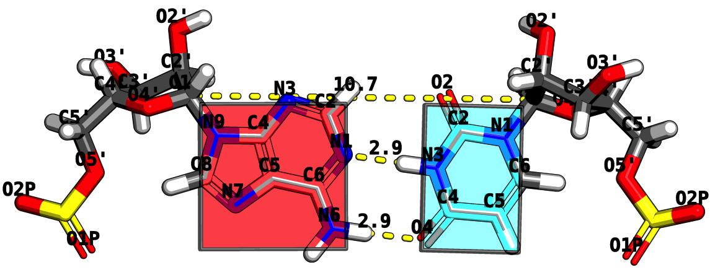
RNA Structure Analysis via the Rigid Block Model
Mauricio Esguerra
October 5th, 2010
Chemistry and Chemical Biology Department
Rutgers, The State University of New Jersey

Slide 2
Program
Opening Act
THE CHALLENGE: How does RNA fold?
Act I
BASE STEPS: Dinucleotide step classification using single-stranded base step parameters.
Act II.
BASE PAIRS: Base pairs in RNA helical regions.
Act III
BASE PAIR STEPS: From local to global properties in RNA with the aid of rigid-blocks.
Act IV
MOTIFS: RNA structural motifs identification using rigid-blocks.
Finale
Notes:
Change it to Act I, Act II, etc. → Intermezzo.

Slide 3
Opening ACT
THE CHALLENGE:
How does RNA Fold?
Is this an easy or hard problem?
Notes:
Look at what is before ACT, to give it a name as motivation.

Slide 4
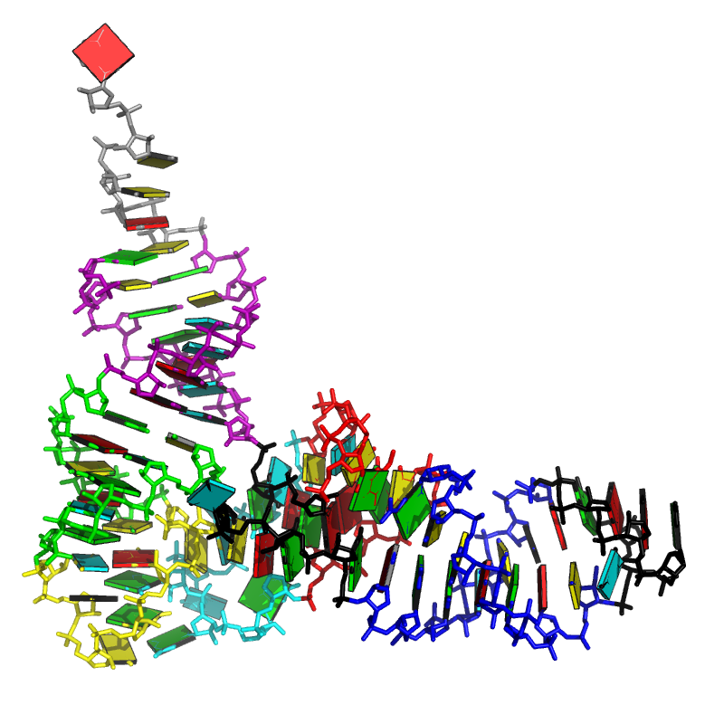
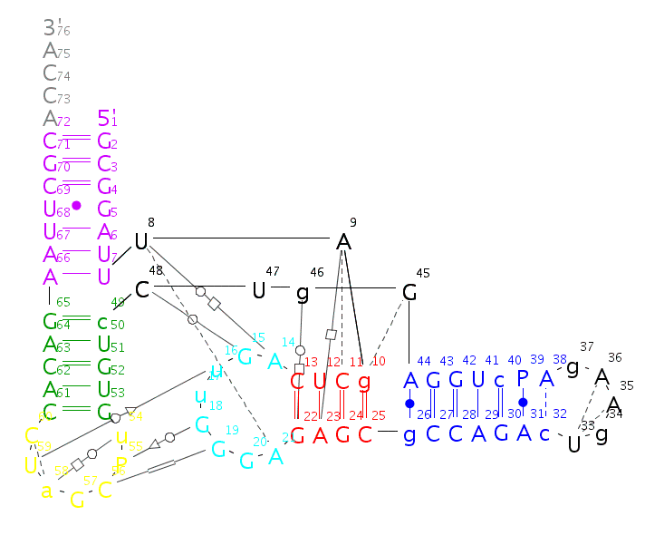
CHALLENGE How does RNA Fold?
GCGGAUUUAGCUCAGUUGGGAGAGCGCCAGACUGAAGAUCUGGAGGUCCUGUGUUCGAUCCACAGAAUUCGCACCA

Slide 5
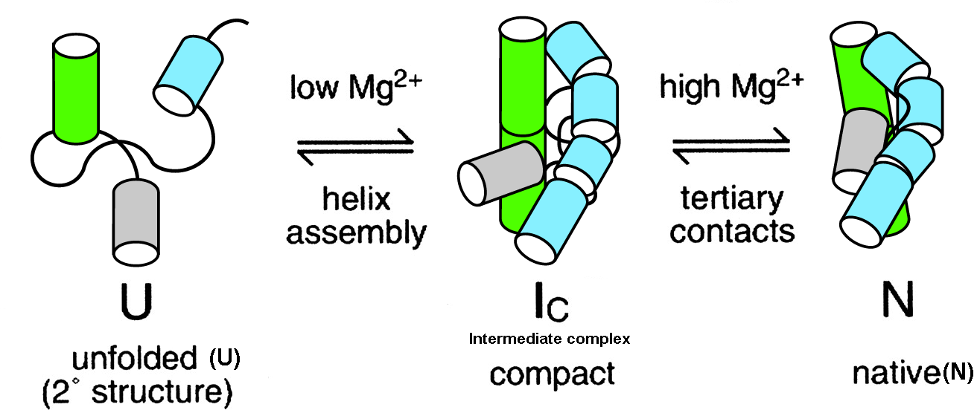
CHALLENGE Is RNA folding a hard or easy problem to solve? After all, the RNA alphabet has only 4 words.
No hydrophobic surface burial.
Polyanionic sugar-phosphate backbone.
Secondary and tertiary separated by Mg2++ addition.
Notes:
Too long.
Have the CHALLENGE IN ALL TO CONNECT TO OUTLINE!

Slide 6
CHALLENGE Usual ways to classify RNA conformations and an unexplored one -- the rigid-body perspective --.
The atom-based perspective
Comparison of backbone atom xyz.
Comparison from set of backbone, sugar, base, atoms xyz.
The bond-based perspective
Covalent bonds – backbone + glycosidic torsions.
Pseudo-bonds η and θ.
Hydrogen bonds forming in edge boundaries (Watson-Crick, Sugar, and Hoogsten).
The rigid-body-based perspective
Base-pair parameters.
Base-pair (base) step parameters.

Slide 7
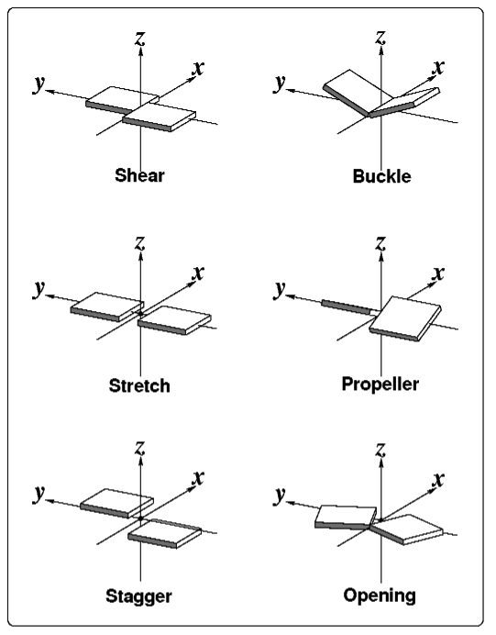
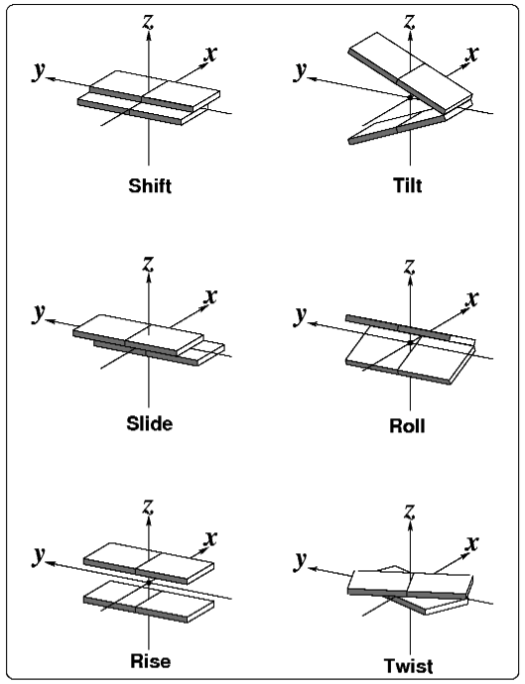
CHALLENGE The mechanical perspective: Nucleic acid bases seen as rigid-bodies.
Base-pair parameters
Base-pair-step parameters

Slide 8
ACT I
Dinucleotide step classification using single-stranded base step parameters
Notes:
Look at what is before ACT, to give it a name as motivation.

Slide 9
BASE STEPS 17 non-A-RNA like structures and 3 A-RNA like kindly provided by Berman and collaborators.
monotonous Helen structures with her numbers in their display type.kindly provided.

Slide 10
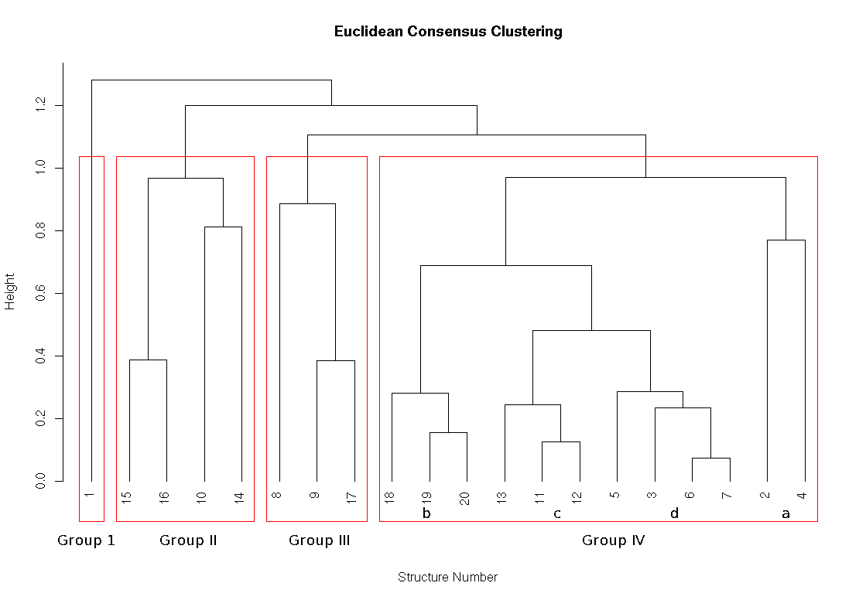
Consensus Clustering message here

Slide 11
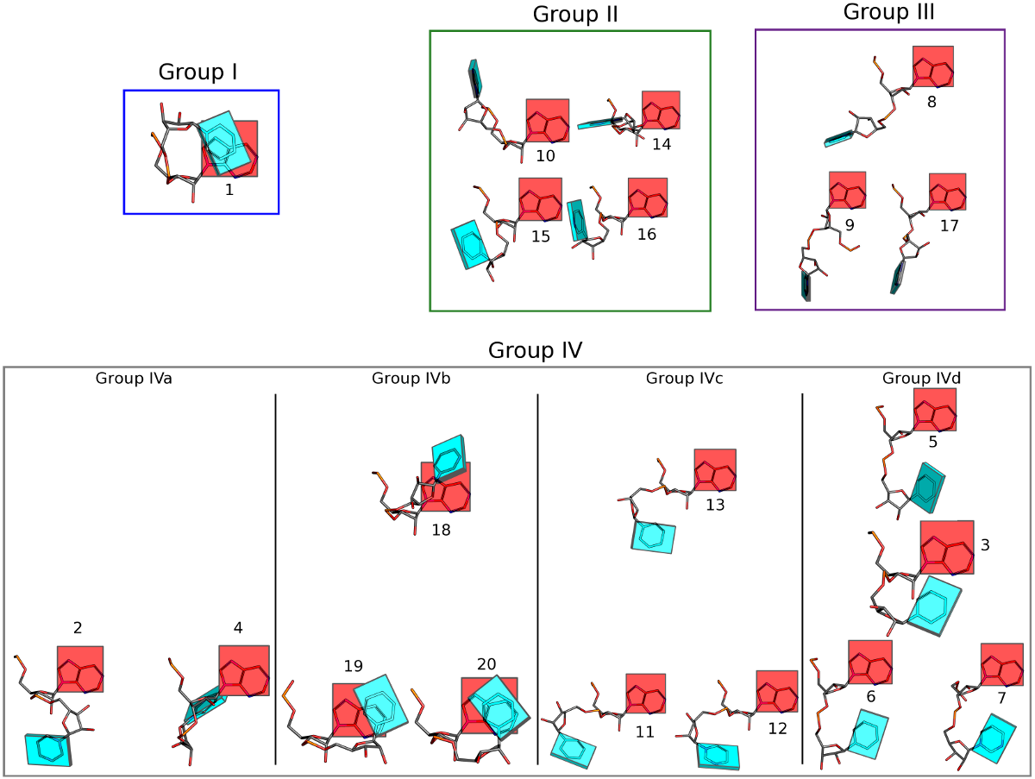

Slide 12
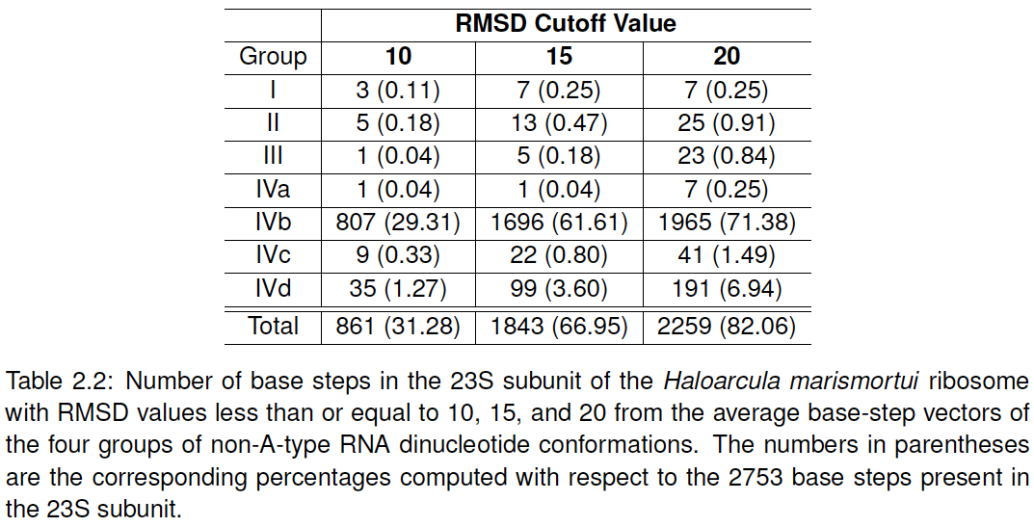
Only small fraction bla 23S -message- rRNA
Picture here of cutoff 10
Notes:
Subscript what’s in parentheses.

Slide 13
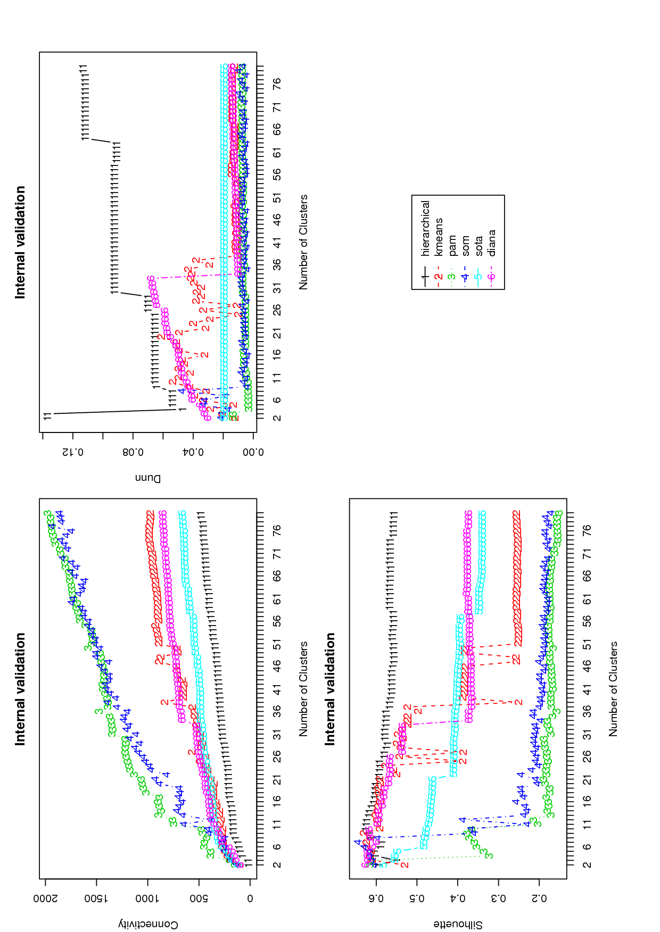
Message rather than just any clustering take advantage from software
Label these
Connectivity is best smaller etc

Slide 14
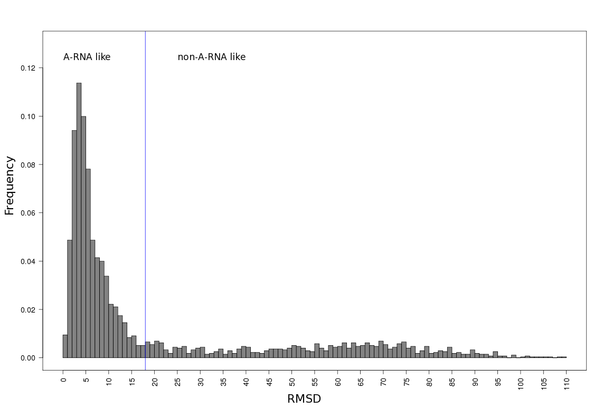
Message comparing with A-RNA
How many in each?

Slide 15
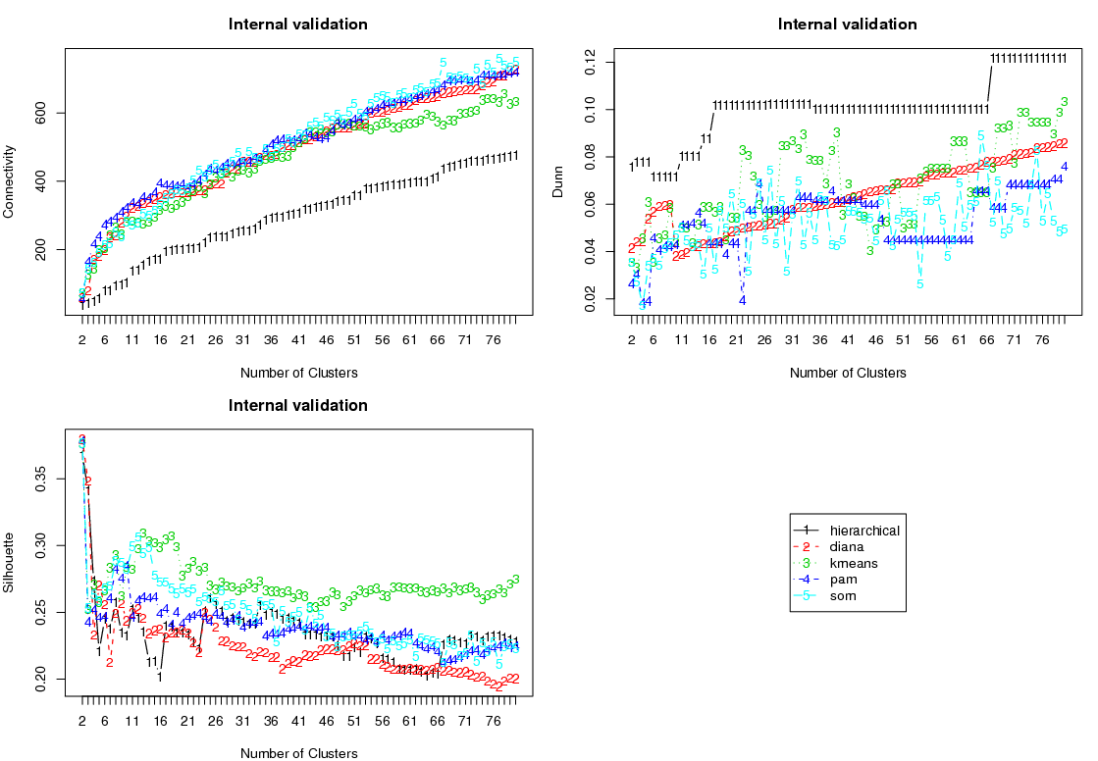
Message here -Non-ARNA-Like Validation
labels
Score better if
67 groups

Slide 16
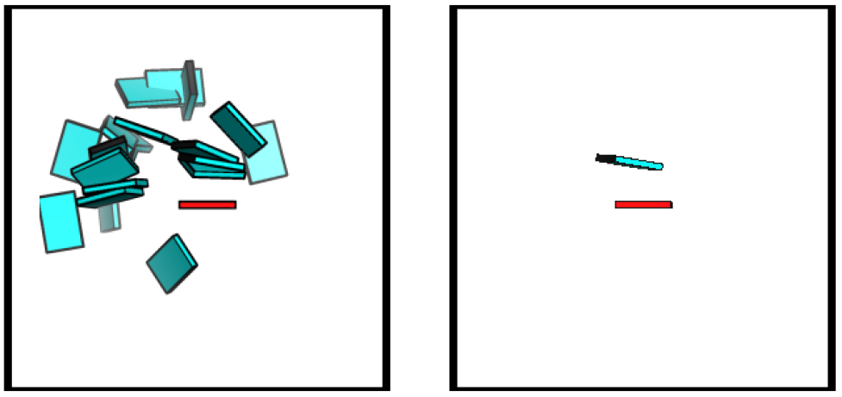
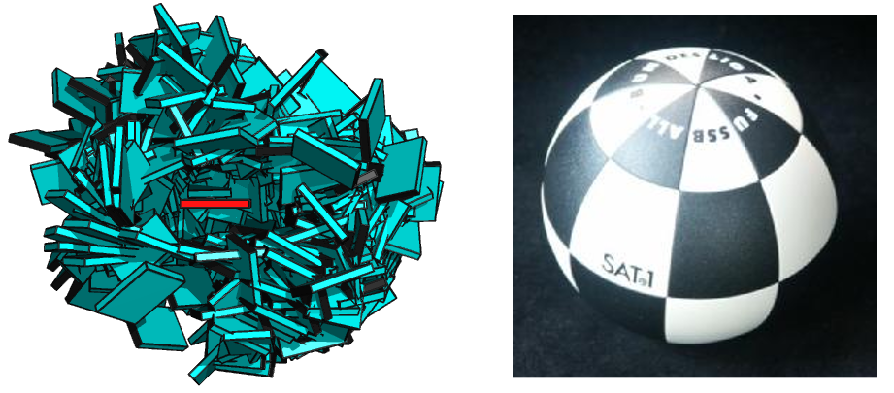
Message here
What are these?
The 67
Helens’
all
No-ball
How many ?

Slide 17
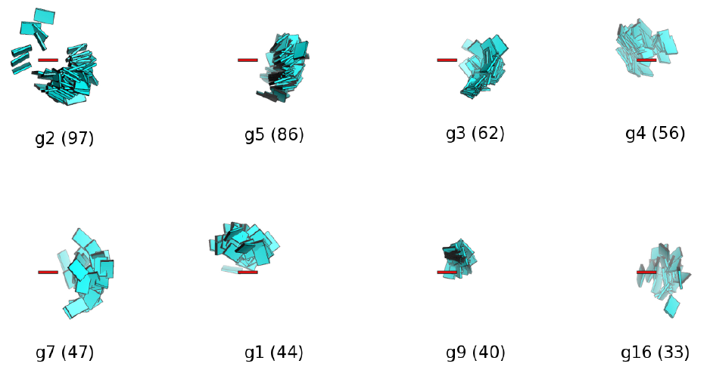
17 Main Non-ARNA-Like Clusters
Percentages of this, better than just how many
What are the missing groups?

Slide 18
ACT II
Base-pairs in RNA helical regions

Slide 19
Picture of helical regions describe.
Quasi-continuous show pictures.
Base-pairing preferences, base-sequence preferences, in helical regiosn which can be linked to tertiary interactions.

Slide 20
Partially Non-redundant RNA Dataset message here
Add line saying is percent
Notes:
MESSAGE HERE THAT ITS GC RICH

Slide 21
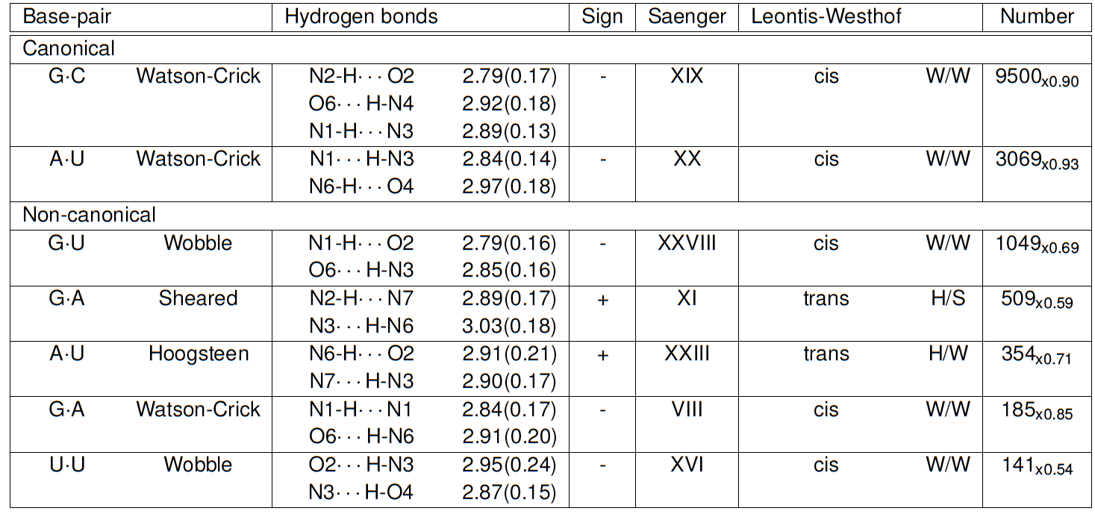
Seven Prominent Base-Pairs phrase in paper

Slide 22
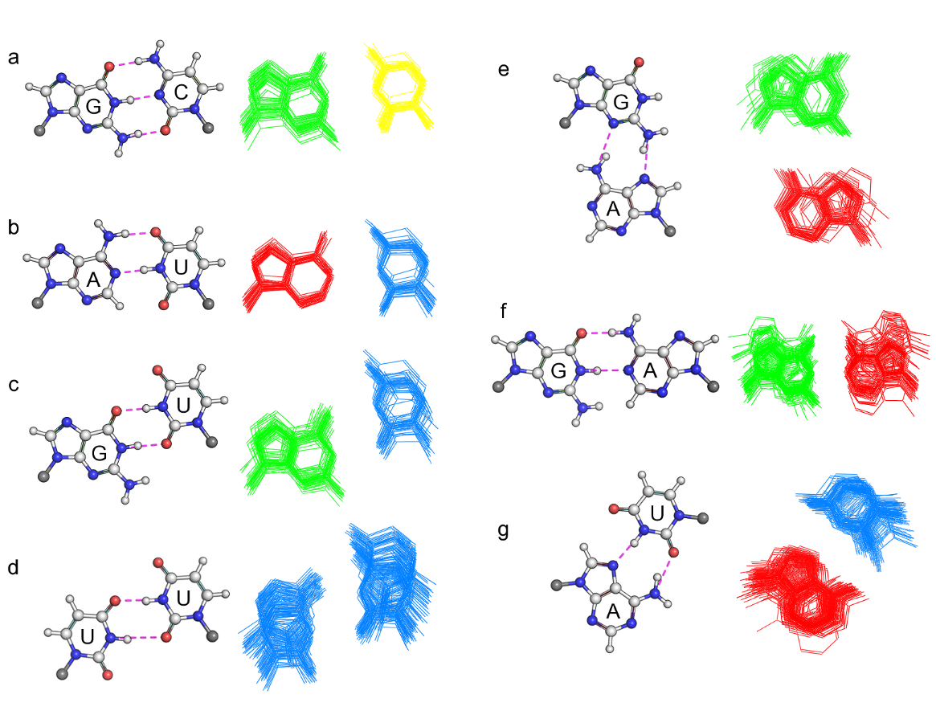
Non-canonical are more deformable. message
Notes:
Add NAMES to them.

Slide 23
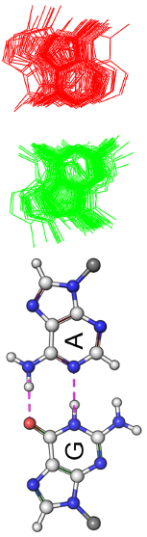
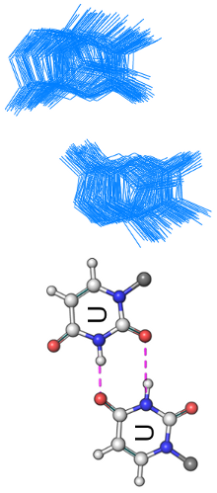
Average Base-Pair Parameters for the Seven.
Talk about analogy

Slide 24
ACT III
Base-pair-steps in RNA helical regions and RNA global properties

Slide 25
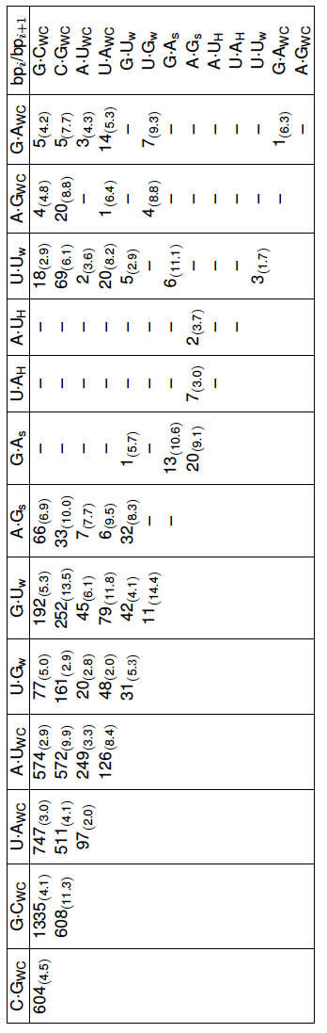
RNA Base-Pairs Steps so Far
Message here: not all possible combinations are seen
Point to examples that stand out.

Slide 26
Just hyperlink to slide
And then go to the site.
Show how it works.
http://rnasteps.rutgers.edu

Slide 27
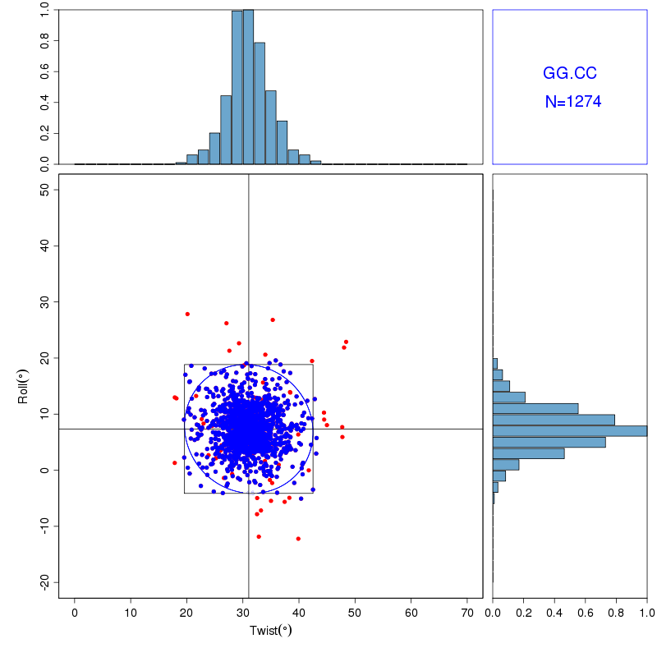
Energy Contours on Culled Data
Notes:
This will just go from going into the website.

Slide 28
Intermezzo

Slide 29
jump to global properties.
Knowledge of adjacent makes it possible to make larger polymer.
Picture with four–five steps, just to illustrate principle

Slide 30
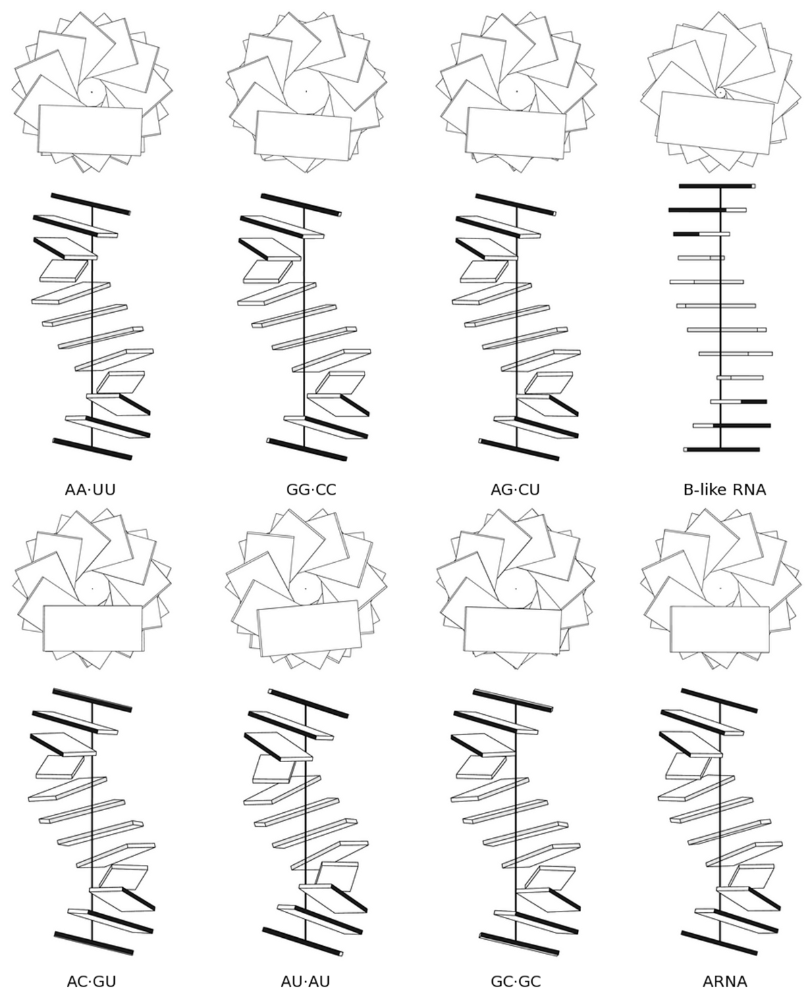
Homopolymers and Block Copolymers
Sequence has suttle effects on
Structure of RNA.

Slide 31
Movie or graph to explain persistence length
Talk about flexibility.
Table of different polymers and their persistence lengths

Slide 32
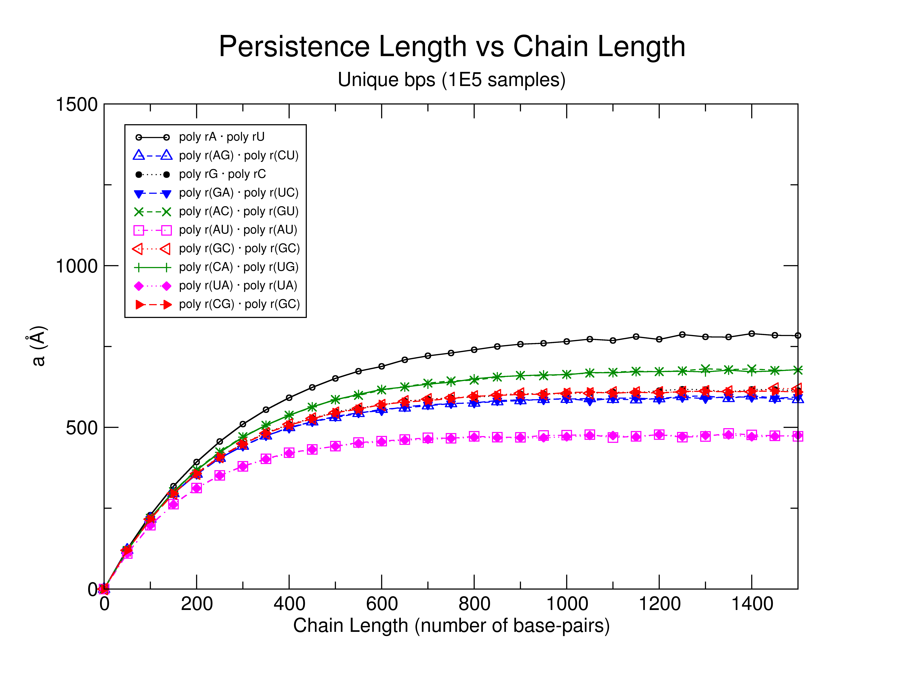
RNA Persistence Length
Message here
Suggest possible sequence
dependence

Slide 33
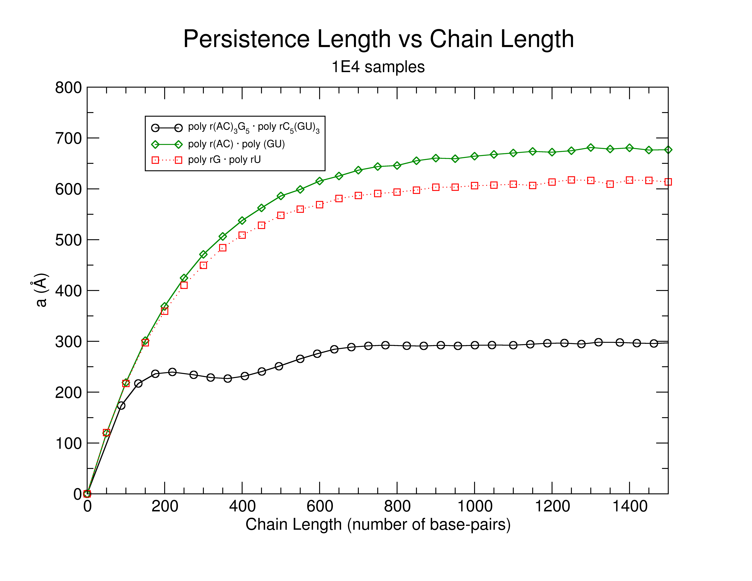
Message her of surprisingly some RNA messages appera to be curved RNA Chains
Notes:
FIX GRAPH

Slide 34
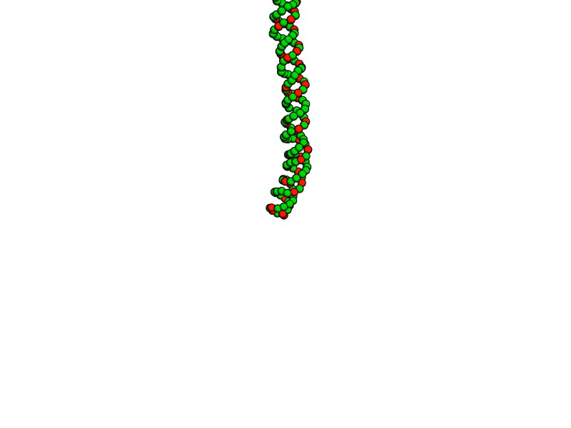
poly r(AC)₃ • poly r(GU)₃

Slide 35
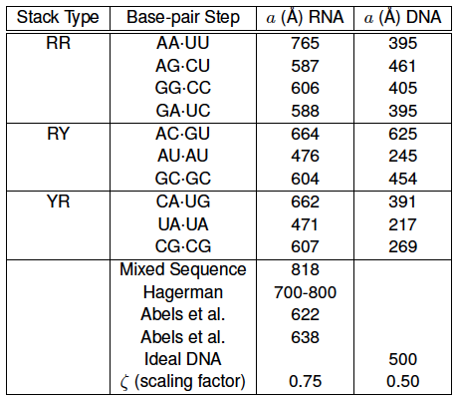
Modelled vs. Experimental a
Just what’s experimental what’s modelled
From x-ray strucutre analysis suggests that RNA is stiffer to

Slide 36
ACT IV
Finding RNA motifs using base step parameters.

Slide 37
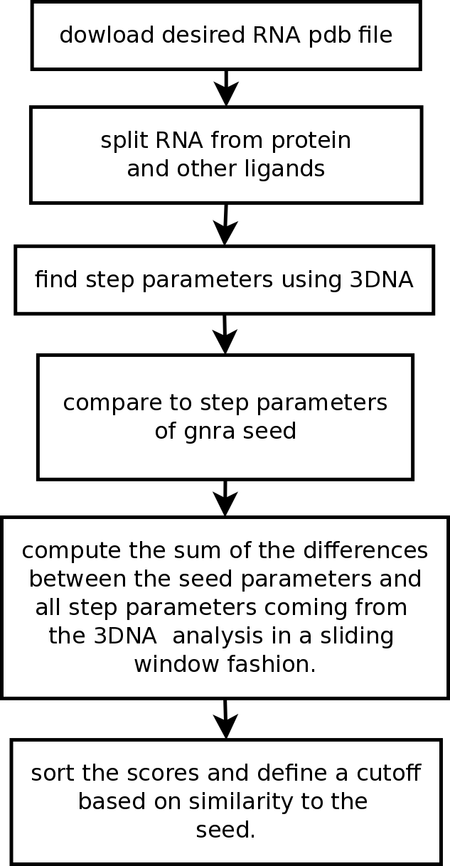
getMotif
Message
Description of software

Slide 38
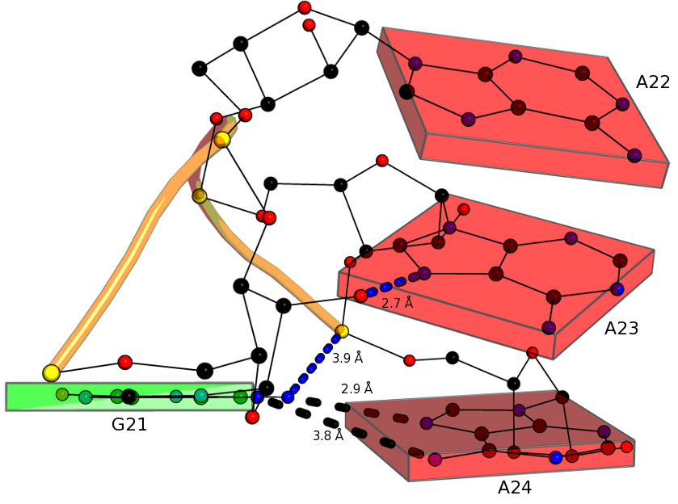
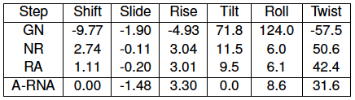
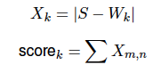
Test GNRA Tetraloop Motif
GNRA Tetraloop provides
Good “toy” model
What do rigid body parameters
Tell you?

Slide 39
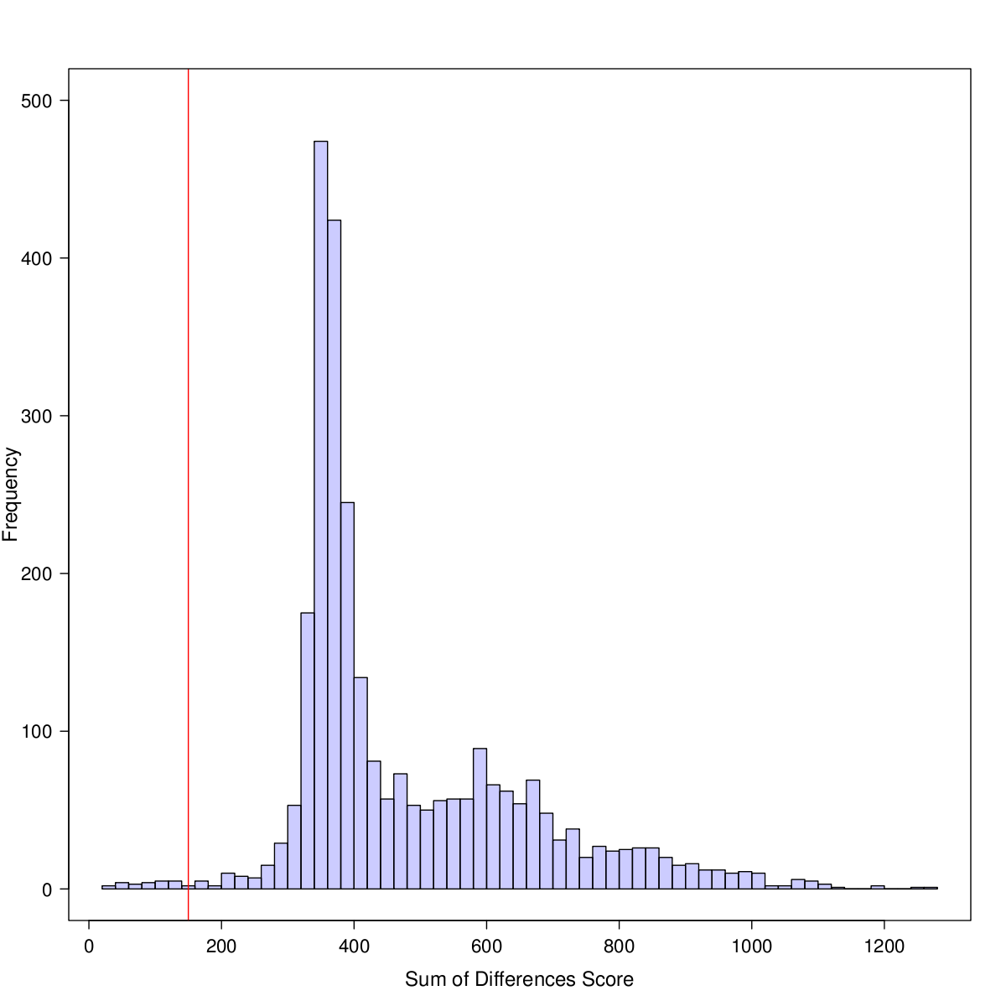
No acronym Score Cutoff
This is for 1FFK
Sliding windows image
Image with matrices in color
Boxes
e.g.
--- ---- ----
---- ---- -----
--- ---- ----

Slide 40
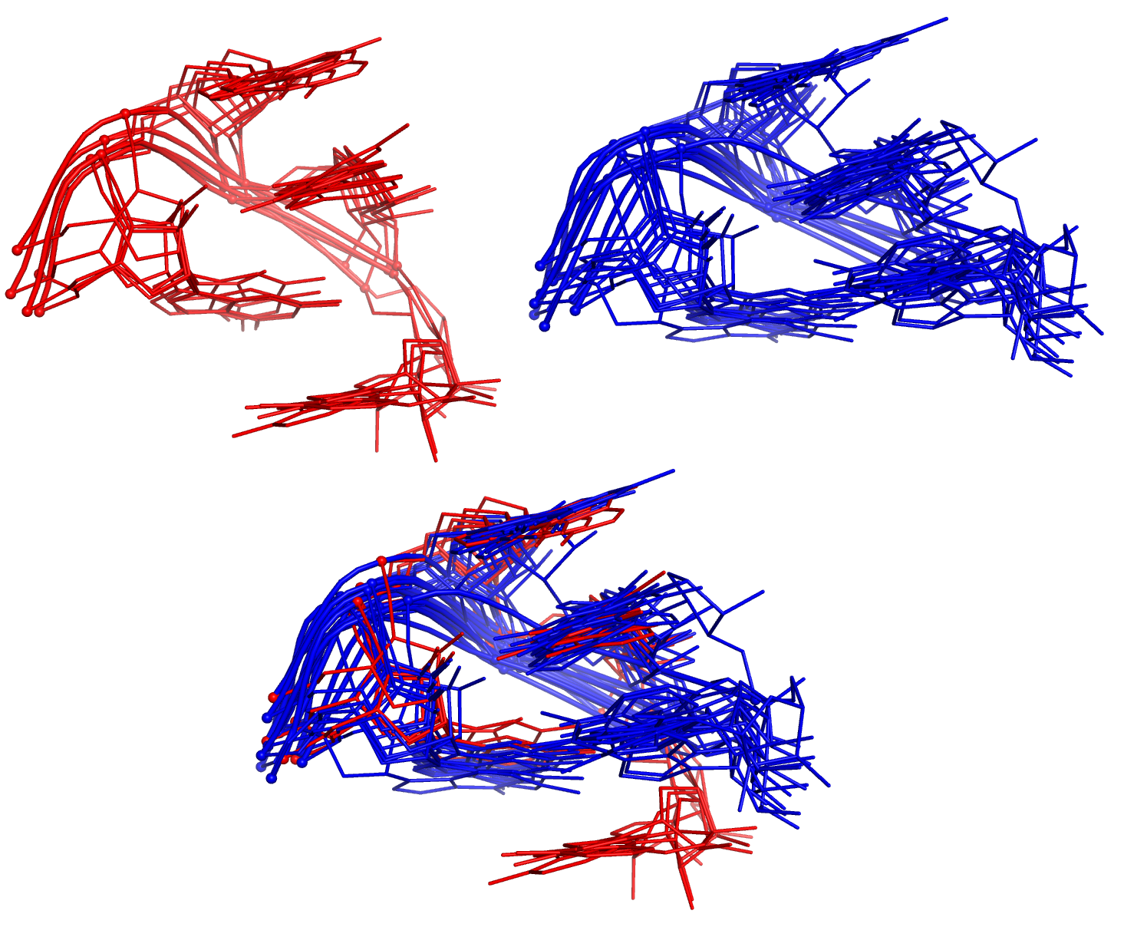
More informations
Software recognixes this motifs
Add base in pentaloops and
Tell how many in other slide

Slide 41
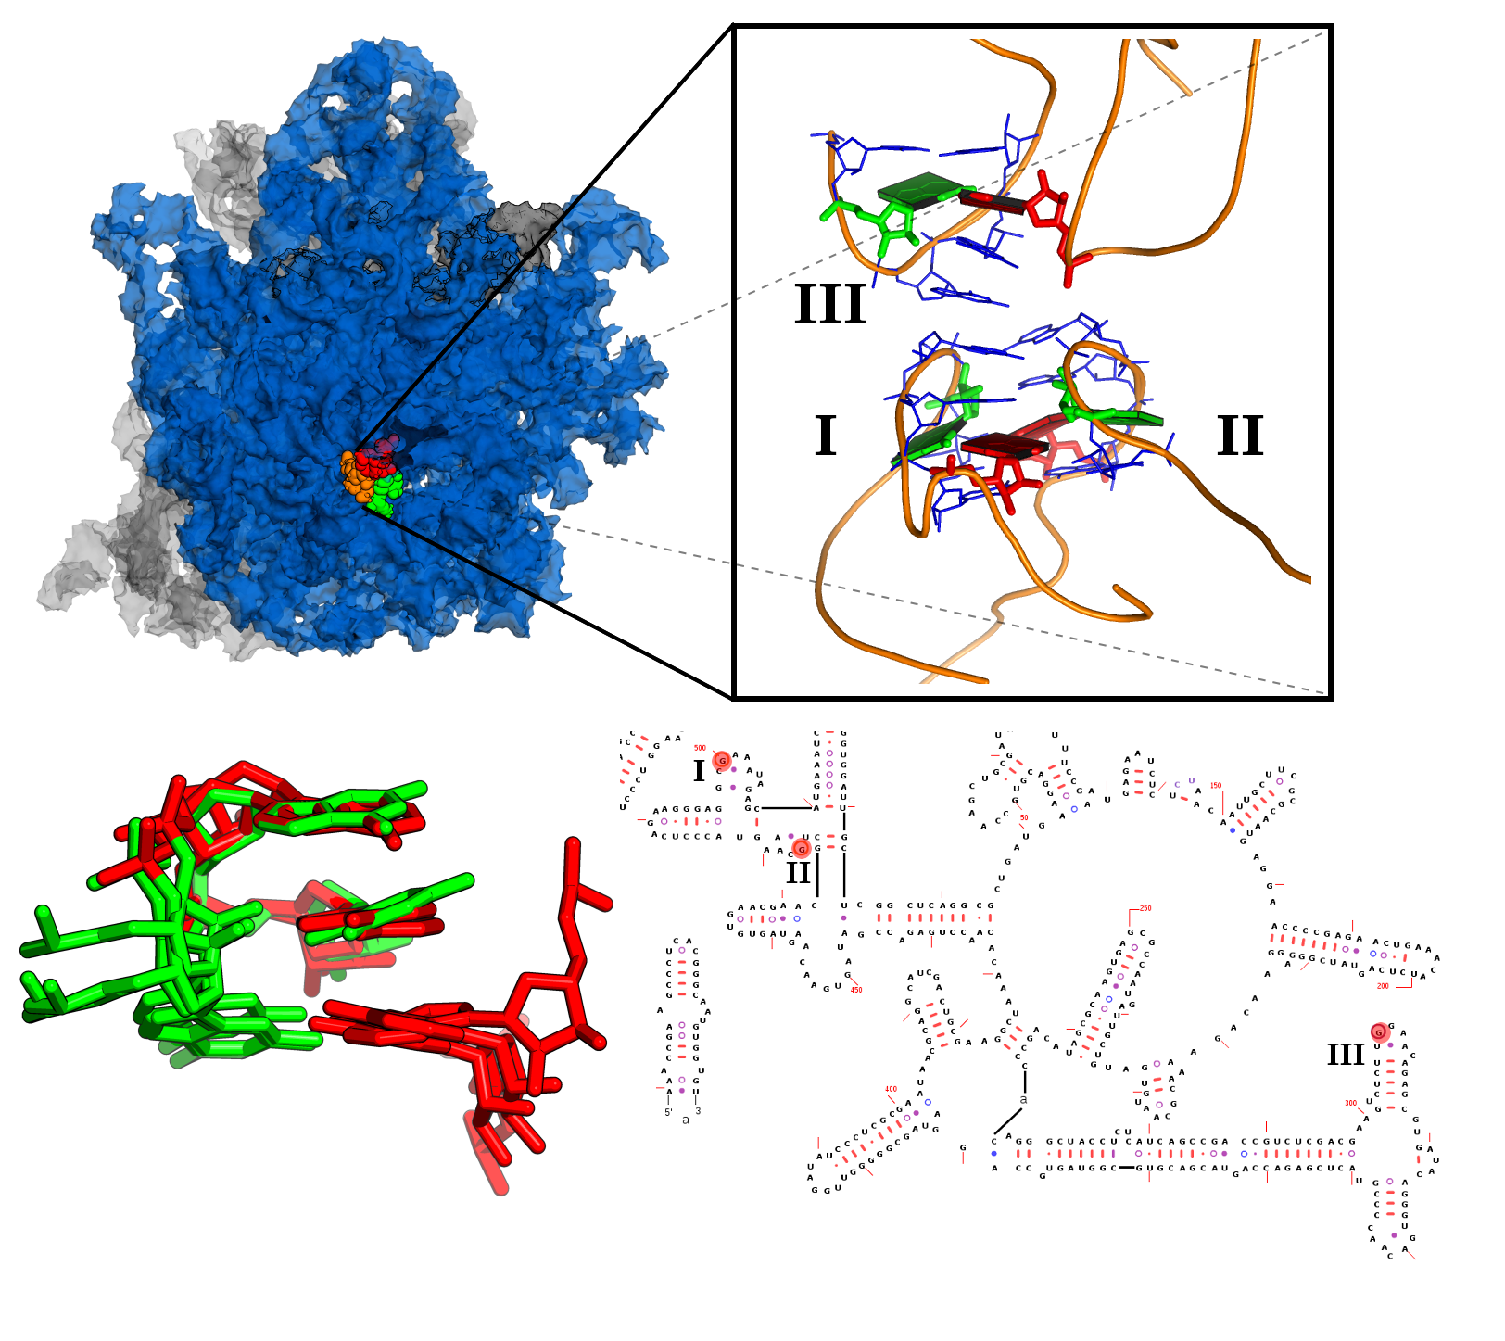
Group II Candidate is Lone-Pair Triloop
This loops
Are ocurring
In such
Just use right side
If figure
In additional ribosome
In left.

Slide 42
Finale
Each act conlcusion or message
Future, open questions. Coming attractions

Slide 43
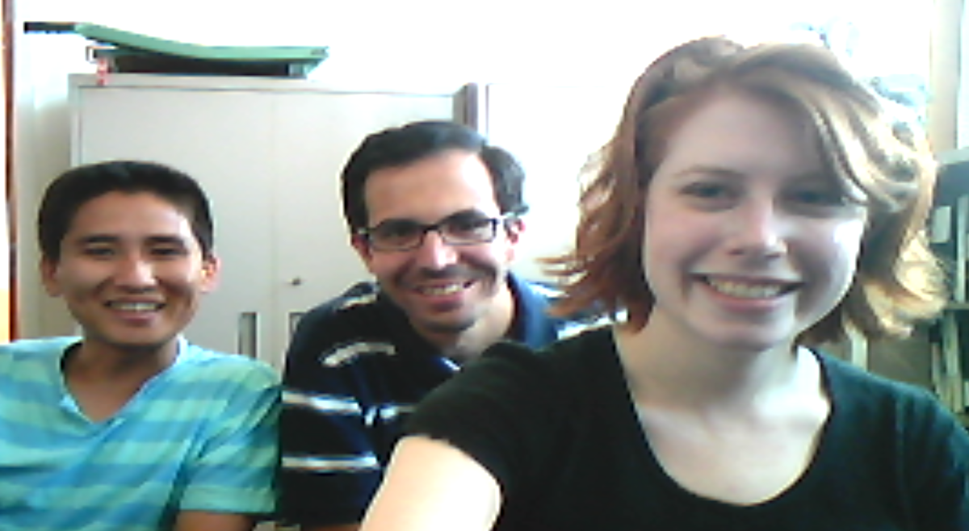
Thanks for yout attention
Thsnk comitte,
Visit us at: http://dnaserver.rutgers.edu
Special thanks to all members of the Olson Lab,
past and present.

Slide 44
